Slide 1
D.Y. PATIL COLLEGE OF ENGINEERING & TECHNOLOGY,
KASABA BAWADA, KOLHAPUR
A
Domain Specific Mini Project Report On
“Rental Rooms and Food Listing Web Application”
Presented by:
Sr. No. Roll No. Name
1 56 Mr.Akash Nandkumar Bhosale
2 57 Mr. Bapu Dattaprasad Valanju
3 58 Miss. Mayuri Mahadev Jadhav
4 59 Mr. Raviraj Manoj Pawar
5 60 Miss. Hrutika Vijay Patole
Under the guidance of
Mrs. Ketaki .A. Bhosale.
DEPARTMENT OF COMPUTER SCIENCE AND ENGINEERING
(2021-2022)
Class : TY Division : B Batch : T3

Slide 2
INTRODUCTION
We faced the problem of finding a perfect and suitable rental room as well as good and healthy food when we first enrolled in this college, and there was no such facility or list available to find it on the internet or from a nearby college . still, our college students are facing the same problem that we faced at that time. To eliminate that, we have developed this project.
This project is designed of the rental of rooms and food, which helps the student find a suitable room and healthy food. It saves them from the manual work, from which it is very difficult to find the location of the room and the mess bills of the students.

Slide 3
PROBLEM STATEMENT
To develop a web application on rental room and rental food places around area and spread awareness amongst all.
Providing owners better platform to showcase their property.to reduce the hustle of peoples.

Slide 4
OBJECTIVES
To reduce the efforts of students for searching of rental rooms and rental food in the locality.
To establish the communication between students and room owners.
Provide platform to owners to list their rooms and mess information.

Slide 5
MODULS
Sign Up/ Log In: User can sign up on site to create an account and use username to post the queries.
Home page: User will see the content of the page and different modules.
Listing page (User): User will see the information or list about,
Properties listed on site.
List of rental rooms for male.
List of rental room for Female.
List of rental food.

Slide 6
SYSYTEM REQURMENTS
Hardware Requirements:
1. Operating system: - Linux/Window
2. Processor: - Intel i3 and Above
3. RAM: - 8GB
4. Web Browser
Software Requirements:
i. Technologies Used: WordPress
ii. Programming Language:
1. HTML
2. CSS
3. JavaScript
4. PHP

Slide 7

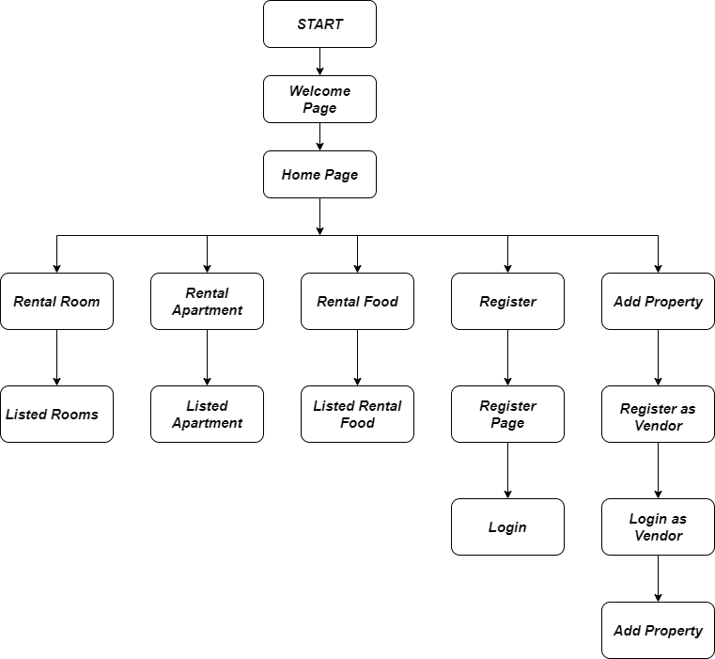



Architecture Diagram

Slide 8
Implementation Details
The above Figure depicts the architecture of Rental Rooms and Rental Food Web Application. The block diagram above gives an overview of the web application. It also shows how user will interact to page and process happens behind it. If user visits on home page as a visitor, then they will be able to see displayed content which contain different tab as Rental room, Rental food, and Registration button, recent added, add property etc. If they go further any of pages, they will see the listed property's which are available for rent and their information such as owner details, location, rent details, description. Then they will be able to contact the property owner for further activities and user can also give ratings for a property to help other users.
If user want to add property, then they have to enter as a vendor of a property then they will have to register for listing their properties for that, user have to visit home page and fill a registration form via registration button given on a home page. Now they will be able to list their property's and their details on website. lastly, we are implementing database for collecting and organizing data which users will fill.

Slide 9

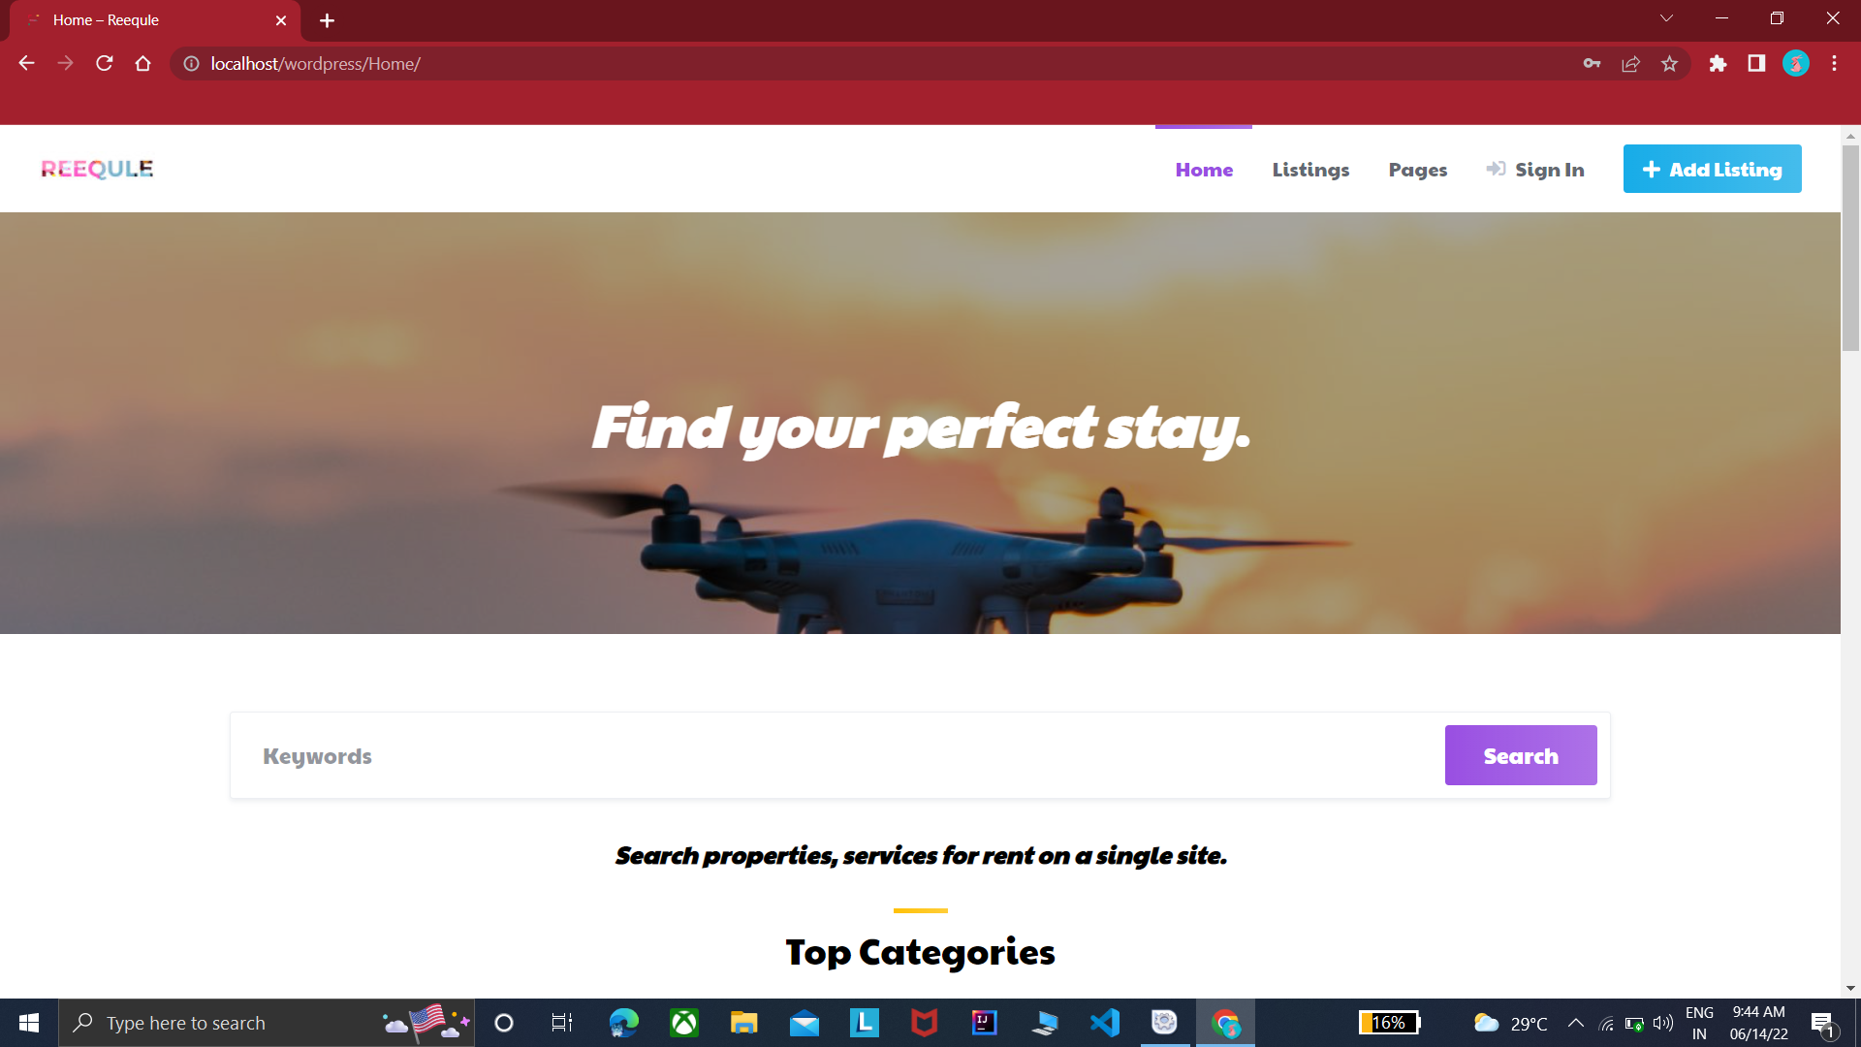

Slide 10
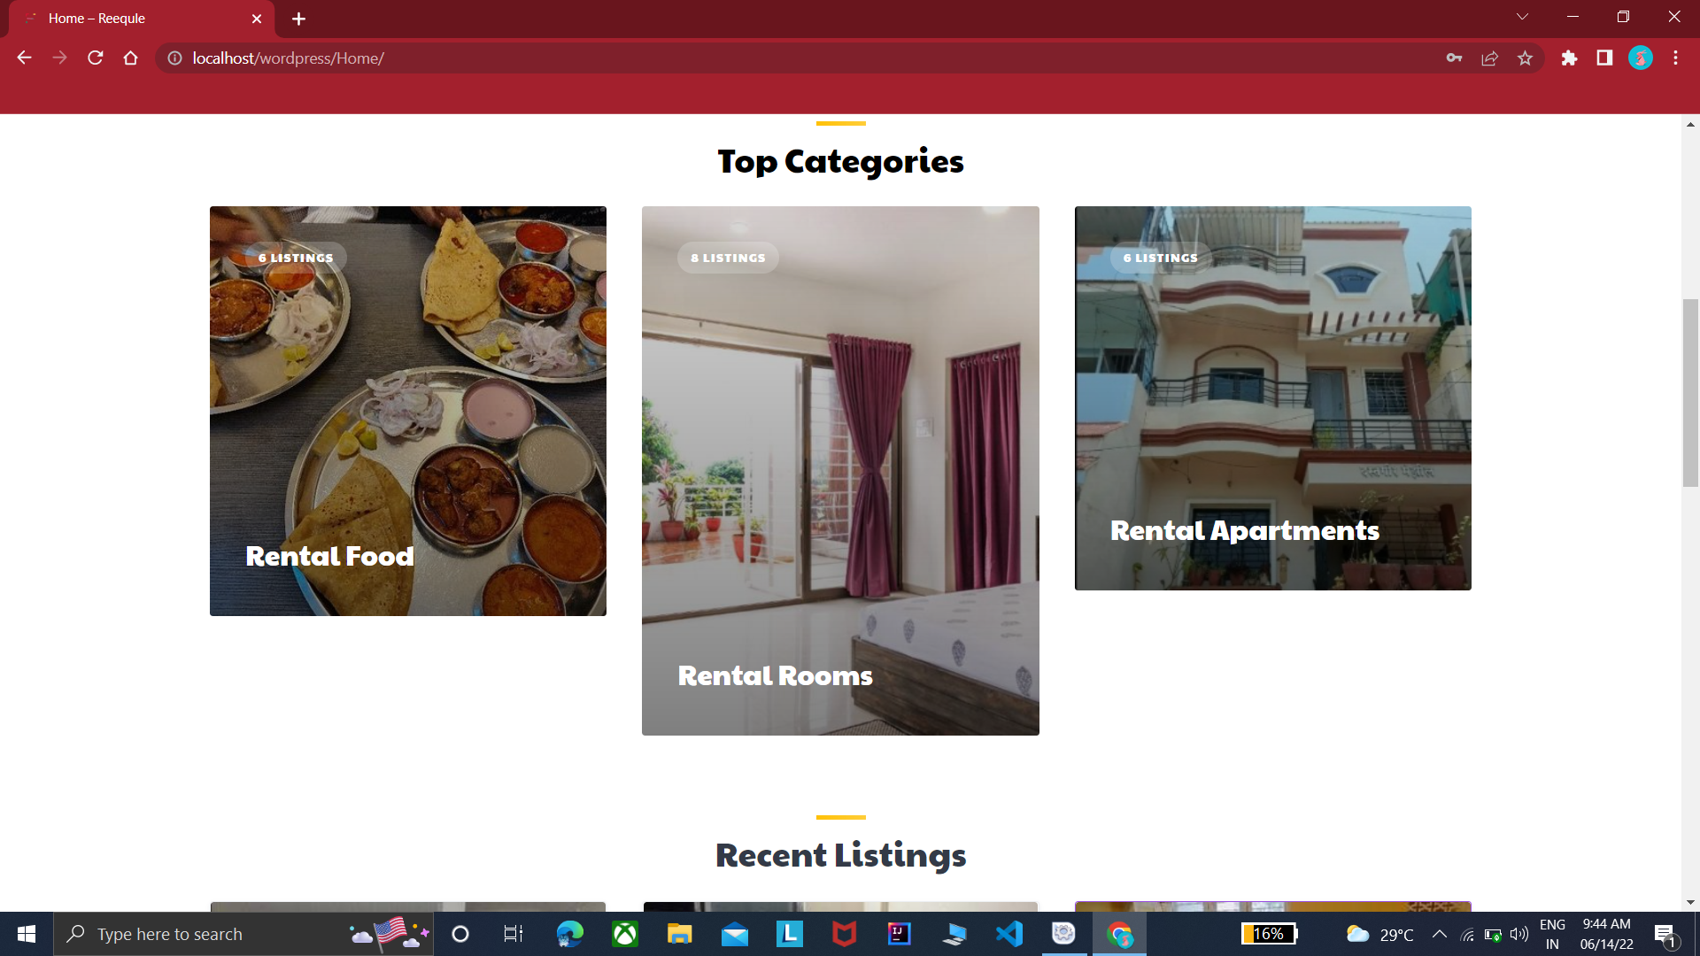

Slide 11
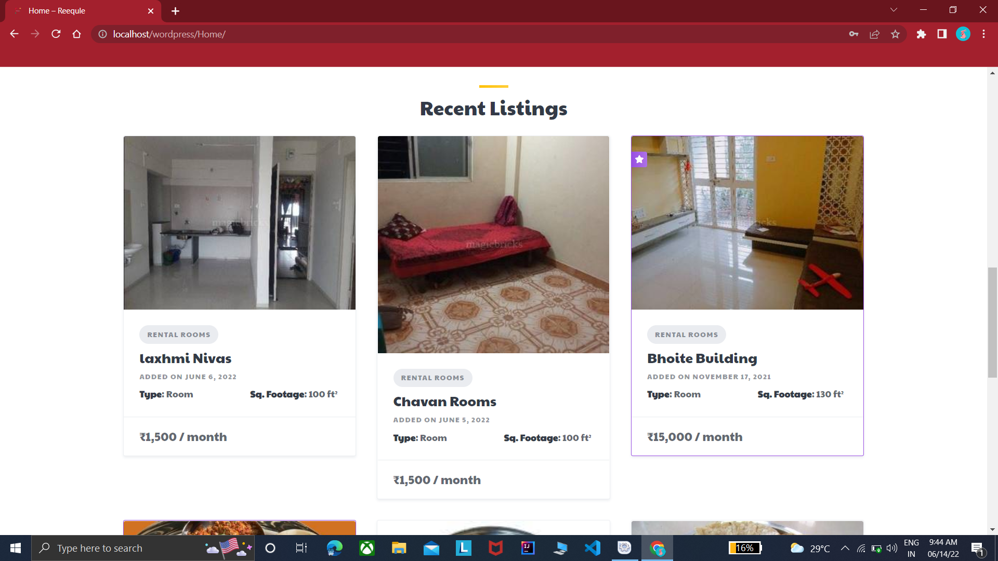

Slide 12
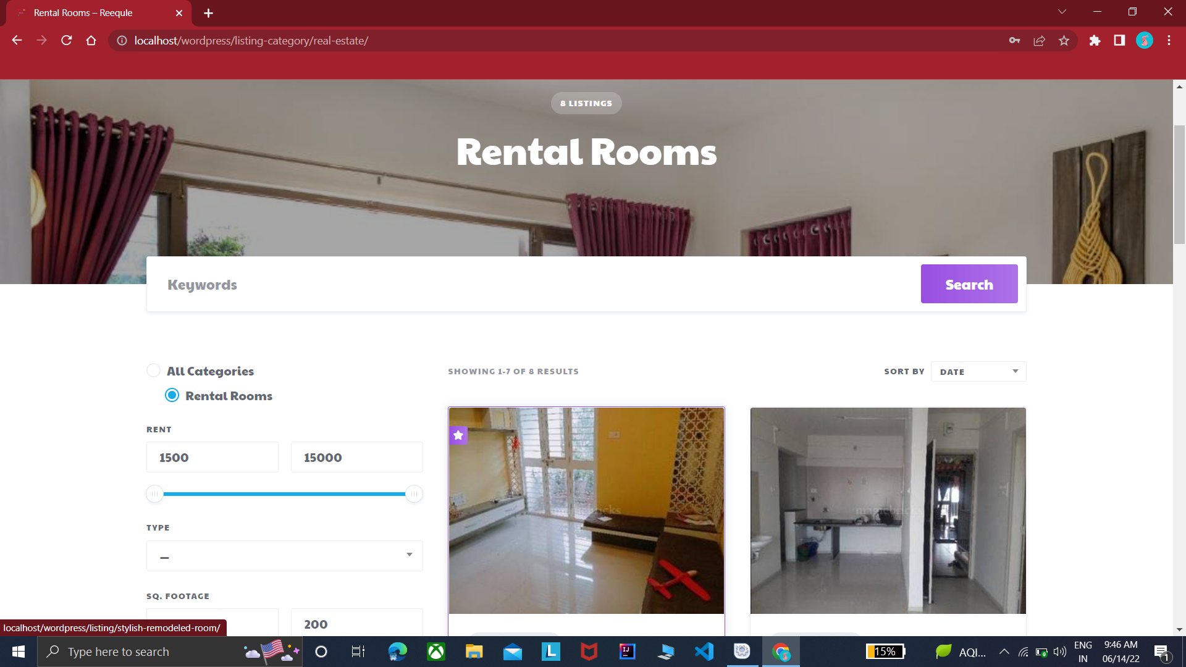

Slide 13
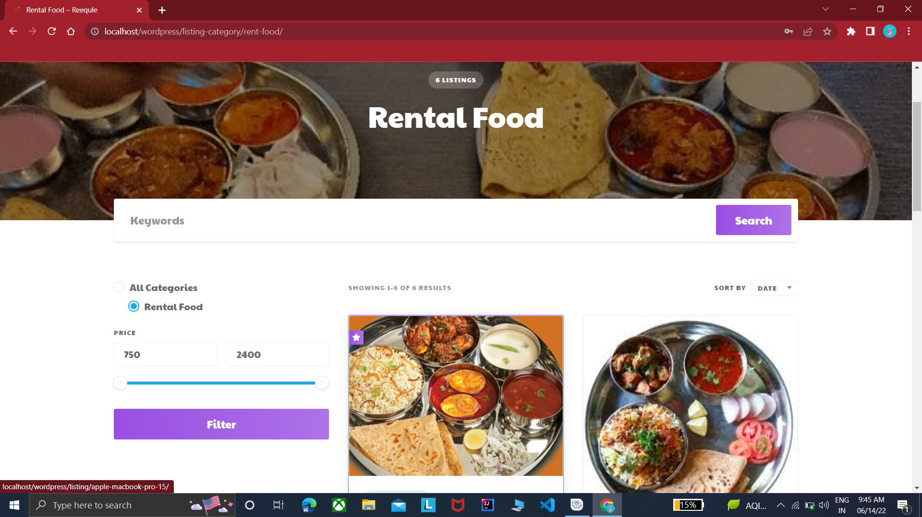

Slide 14
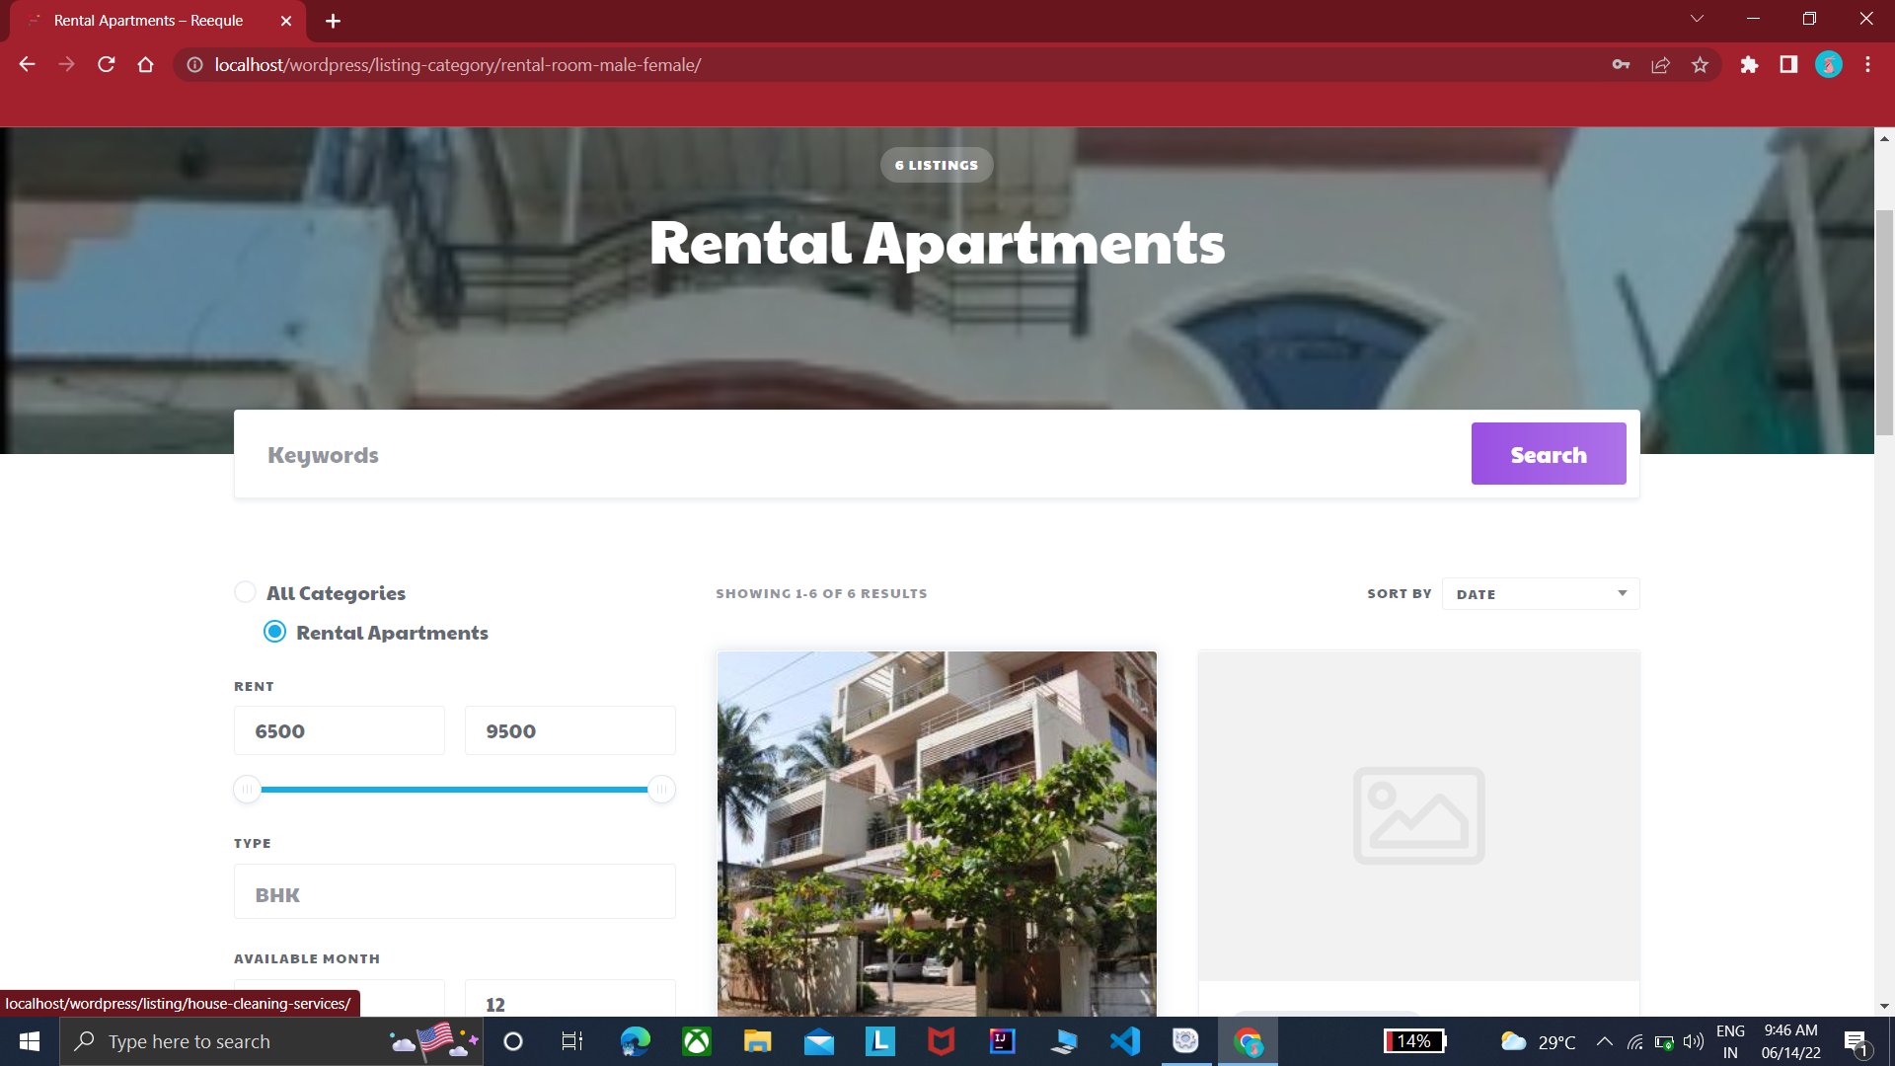

Slide 15
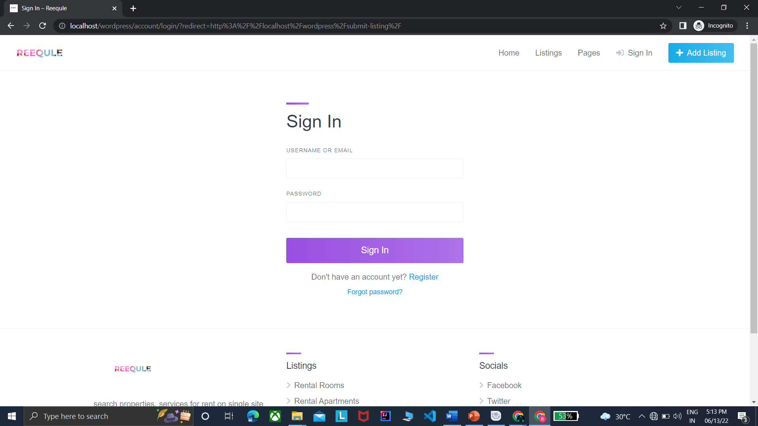

Slide 16
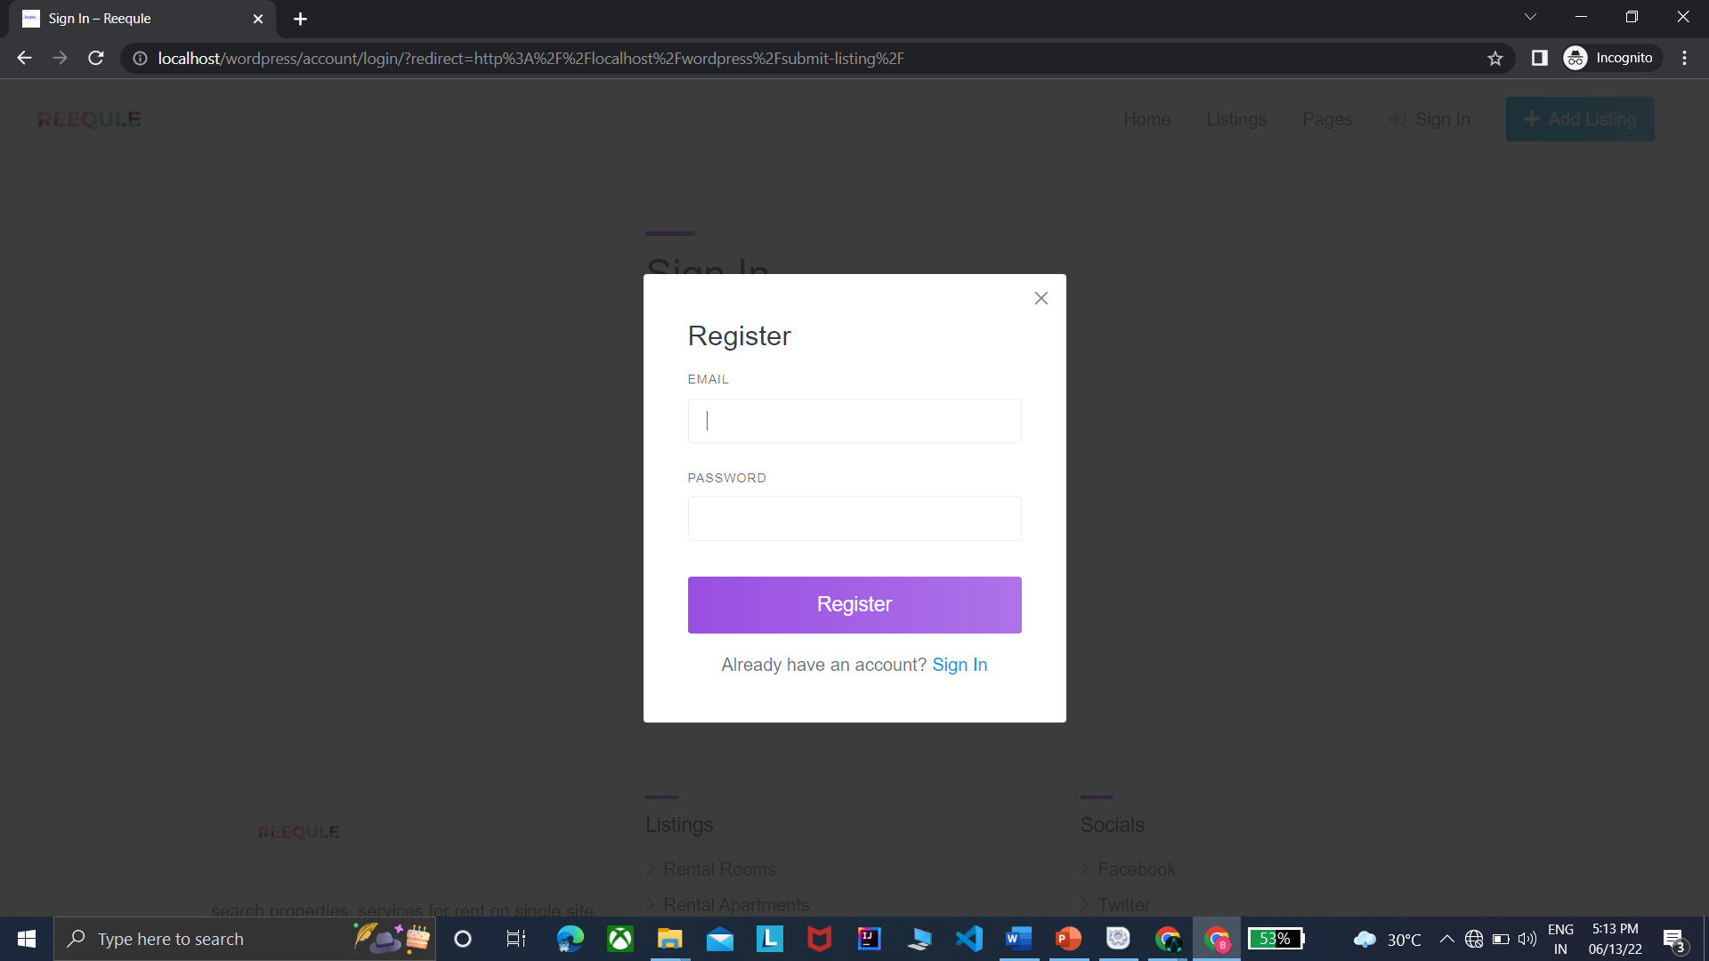

Slide 17
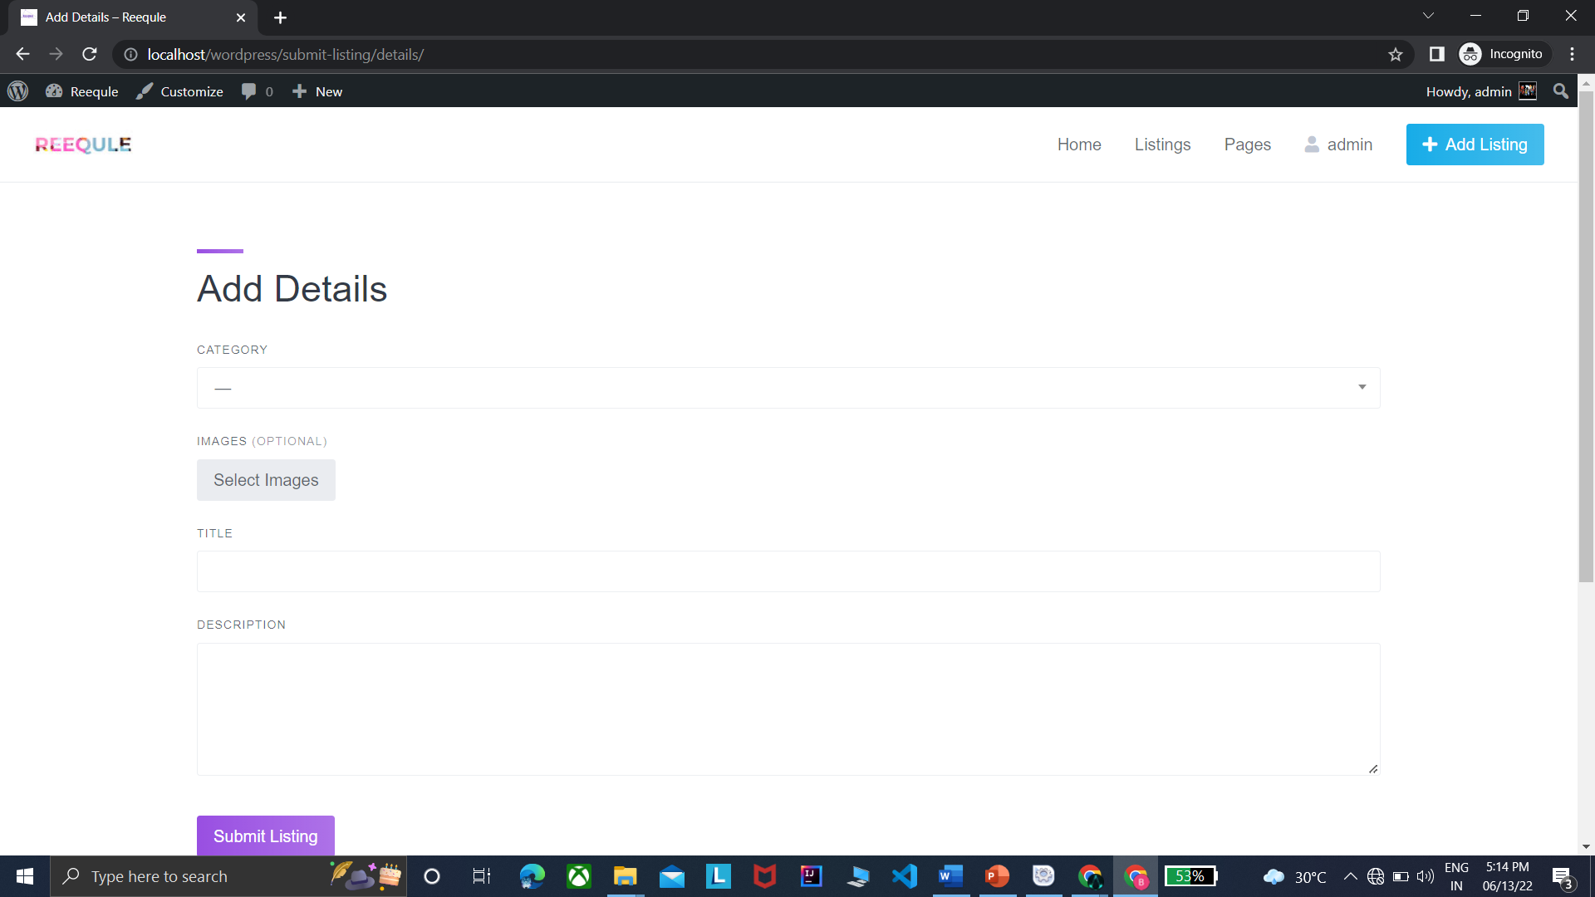

Slide 18
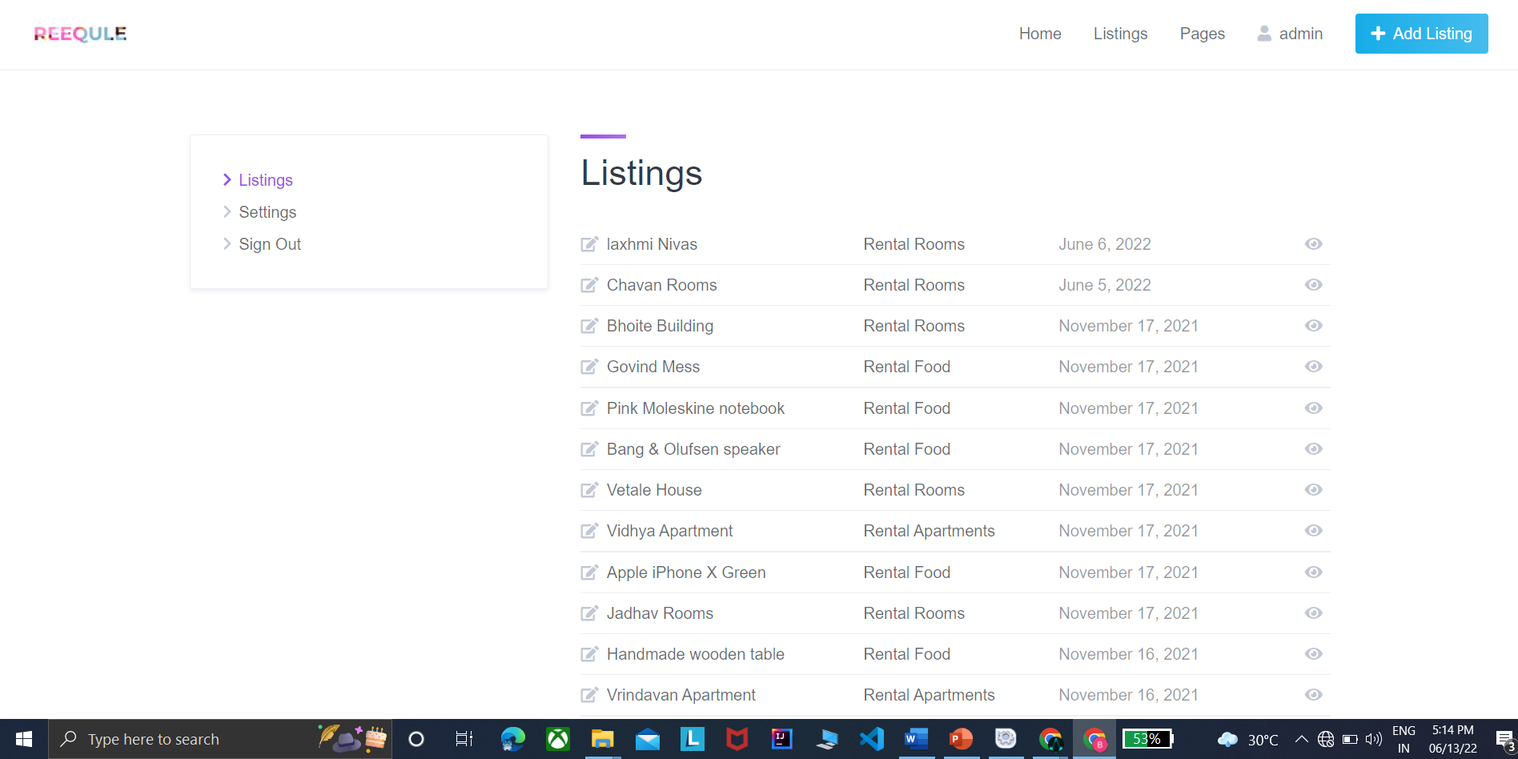

Slide 19
CONCLUSION
In this project, program provides an interactive web application to list rooms and mess around the locality, it is the more efficient way to find suitable place. To establish the communication between students and room owners. Provide platform to owners to list their rooms and rental food information.
This Application would not only help people but also spread awareness amongst all. In Future a new function or procedure can be easily added in the system through adding new modules.

Slide 20
REFERENCE
Web Design With HTML , CSS, jQuery set
JavaScript : The Definitive Guide
SQL: Learn SQL (using MySQL) in One Day and Learn It Well.

Slide 21
Thank you

